Slide 1
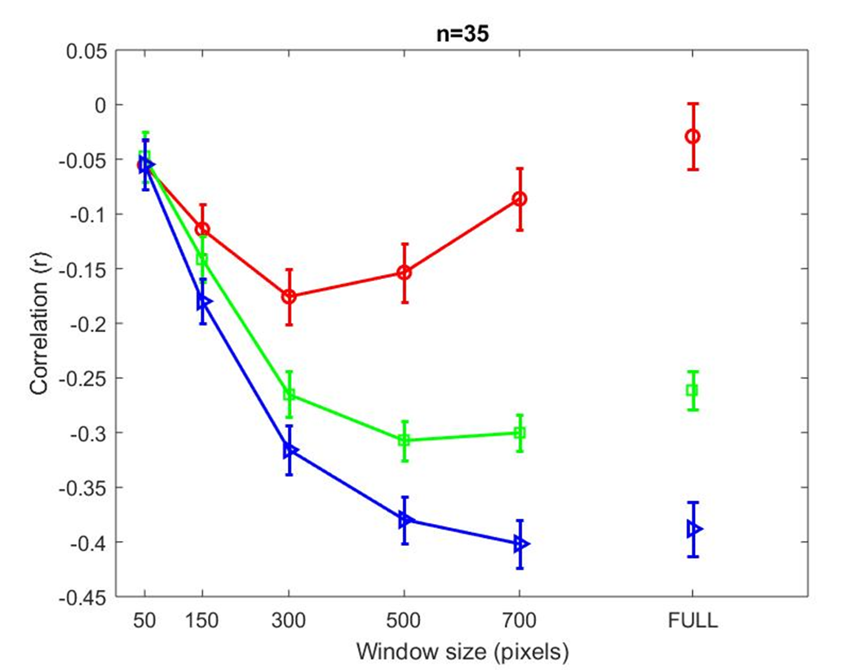
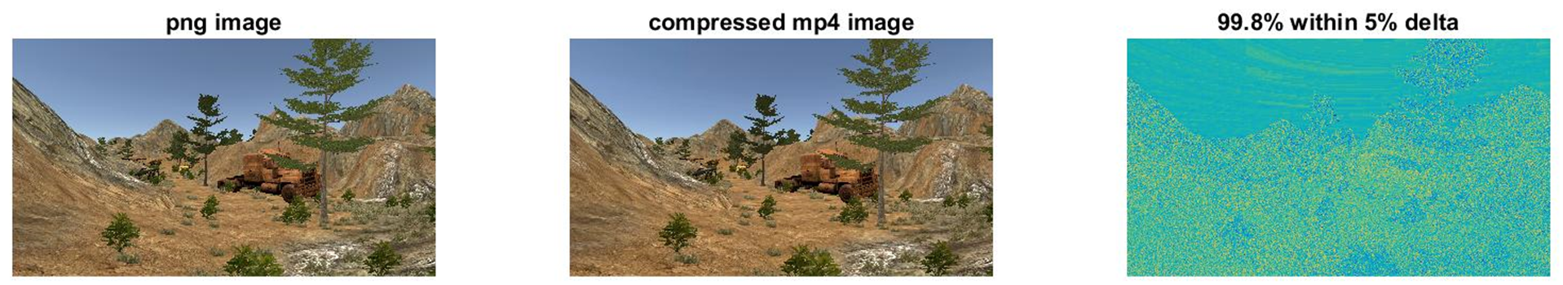
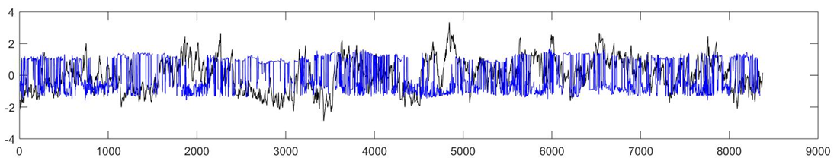
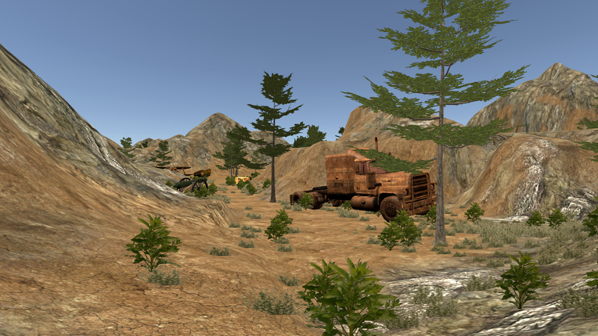
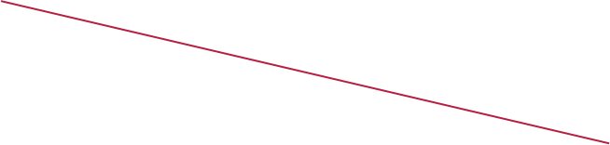
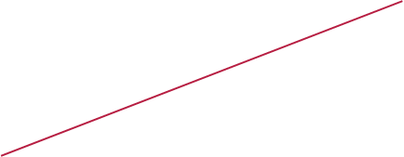

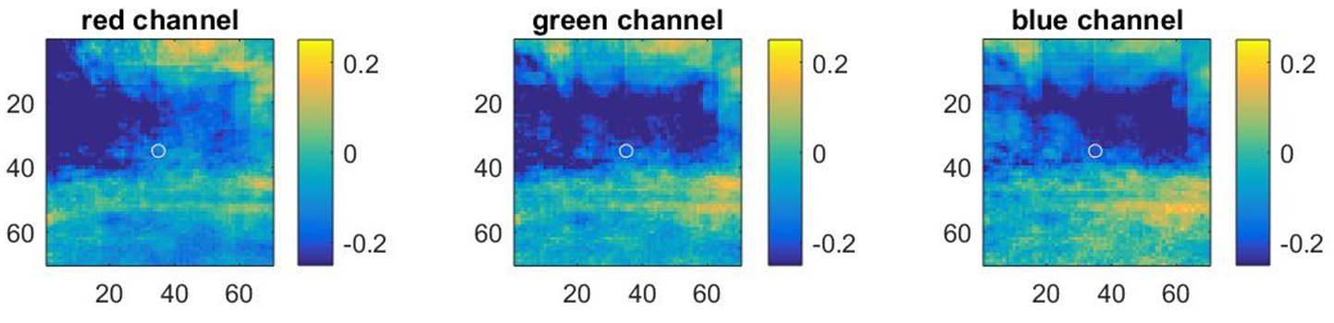
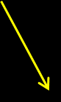








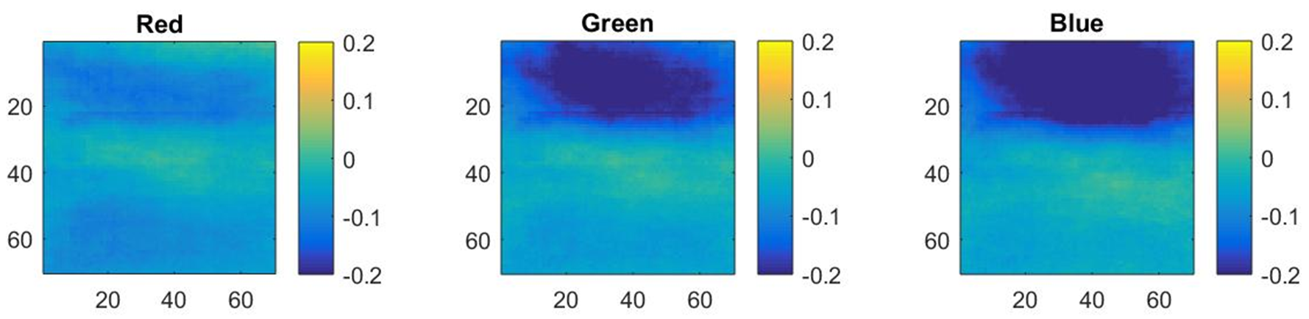
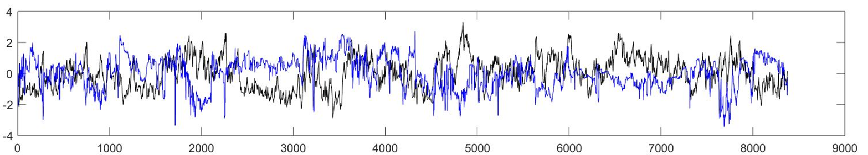
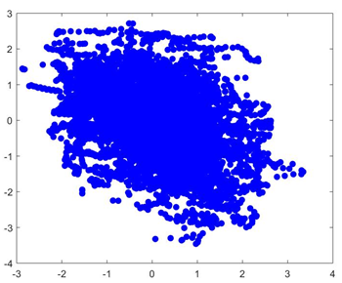
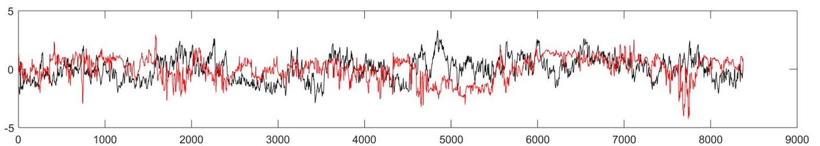
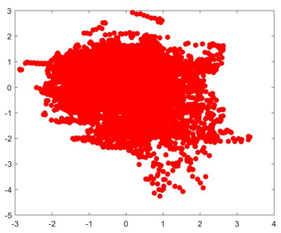
The influence of dynamic Visual scene statistics on pupil size
Peter Hanson, Russell Cohen Hoffing, Steven M Thurman
Introduction
Pupil size is influeced by cognitive factors like mental load and decision making, but also by non-cognitive factors like luminance and visual scene properties.
Better models are needed to account for the impact of luminance in dynamic and ecologically valid contexts in order to transition pupillometry-based technologies outside of the controlled laboratory environment.
We investigated the influence of visual scene properties derived from Red, Green and Blue (RGB) channel intensities on pupil size changes during a 12 minute navigation task through a rich 3D virtual environment.
Does the relationship between pupil size and RGB values differ by window size?
The strongest correlations come from relatively broad window sizes of 500-700 pixels for blue and green channels
The red channel had a weaker influence on pupil size and a narrower influence over space around the gaze point that peaked around 300 pixels in size.
These relationships were extremely consistent across subjects (n=35)
Does image compression into MP4 format introduce noise?
Snapshots per subject take up 200GB
We used down sampling and MP4 compression to reduce file size
Compression led to a small loss of data fidelity and only minor artifacts
Storing the sequence of snapshots as mp4 reduced file size to only 1-2GB per subject (98% reduction)
Does the relationship between pupil size and RGB values differ by pixel spatial location?
A pixel-by-pixel correlation analysis shows that pixels above fixation are most negatively correlated with pupil size while below the fixation is positively correlated
This relationship is consistent across most subjects
This may be due to a “blue sky” effect whereby eye movements to regions near the horizon with bright blue sky caused a strong constriction response of the pupil.
Do scene statistics (i.e. RGB values) influence pupil size changes?
Pupil size changes in response to scene brightness (i.e. brighter pixels tend to lead to pupil size constrictions)
We extracted mean RGB intensity values from different sized circular windows surrounding the gaze point from 50-700 pixels
Hypotheses
Hypothesis 1: Pupil size will be negatively correlated with pupil size
Hypothesis 2: The largest correlations will be derived from small or intermediate sized windows around the point of gaze
Hypothesis 3: There may be differences in the relative influence of red, green, and blue color channels
SINGLE SUBJECT EXAMPLE
GROUP-AVERAGED MAPS
Analysis technique
We examined Pearson correlation coefficients between pupil size (black lines below) and mean R,G,B intensities
As an example below, we found that blue (top) and red (bottom) channels were negatively correlated with pupil size
The blue channel had a much stronger negative correlation with pupil size than the red channel
Conclusion
The blue channel had the largest impact on pupil size whereas red channel had a much weaker influence
Specifically, blue pixels above fixation tended to be most predictive of pupil size, which we hypothesize is due to the brightness of the blue sky in causing pupil constrictions when subjects looked near the horizon.
We can use this knowledge to develop better models of the influence of visual scene properties on pupil size, and then we can better estimate cognitive-driven changes to pupil size.
Notes:
Small/medium/large funding/staffing
Small <$250K (~1 man year)
Medium $250K - $1M
Large > $1M
Talking Points
ARL Contribution
In what parts of this research does ARL lead the scientific community?
What is ARL’s niche?
Identify complementary work occurring in other parts of ARL.
Collaborations
Discuss internal and external partners, their affiliations, and the contribution of each to this project.
Include email addresses of the ARL PIs.

